Slide 1
Business Systems Intelligence
Lecture 3
Data Warehousing - II

Slide 2
What did we do last time?

Slide 3
Summary
Last week we started looking at data warehouses
What is a data warehouse?
OLTP versus Data warehouses
Data warehouse architecture
Building a data warehouse
Data warehouses, data marts and virtual warehouses

Slide 4
Outline
Today we will begin to look at: How do we model data in the Data Warehouse?
Entity-Relationship (ER) Modelling
ER modelling is a design technique in which we store the data in highly normalized form inside a relational database.
Dimensional Modelling
Star Schemas

Slide 5
On Normal Forms and ER Modelling

Slide 6
Relational Modeling for Transactional Databases
Relational modeling approach works by dividing the data into many discrete entities.
Each entity becomes a table in the physical schema.
Why has it been so successful?
Simplicity of database structure
Flexibility of relationships
Coupled with the concept of Normalization it removes redundancy from the database
Update (or insert or delete) the data at just one point
Can build very fast access methods (index)
Results in efficient transactional processing
Notes:
An index is a copy of select columns of data from a table that can be searched very efficiently that also includes a low-level disk block address or direct link to the complete row of data it was copied from.

Slide 7
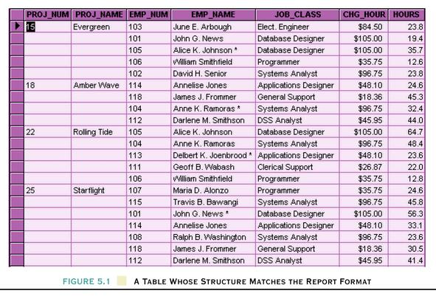
Remember: Normal Forms
Normal Forms are increasingly better organized versions of the data which reduce storage requirements and simplify the data for manipulation and reference in transactional operations.
In Relational Databases we want to get away from this
Notes:
ACID (Atomicity, Consistency, Isolation, Durability)

Slide 8
Database Normalization
Remember, Normalization works through a series of stages called normal forms:
First normal form (1NF)
Second normal form (2NF)
Third normal form (3NF)
Fourth normal form (4NF)

Slide 9
Database Normalization
First normal form (1NF)
each table should be organized into rows
each row should have a primary key that distinguishes it as unique
any row must not have a column in which more than one value is saved, like separated with commas, for example
using the First Normal Form, data redundancy increases, as there will be many columns with the same data in multiple rows

Slide 10
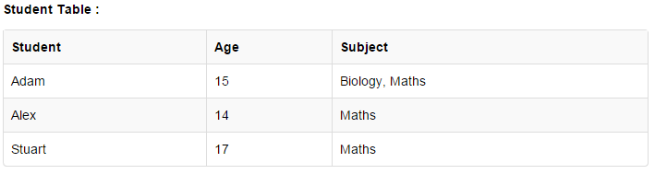
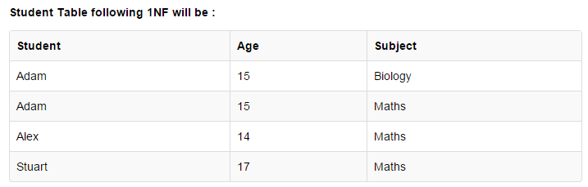
Database Normalization
First normal form (1NF)

Slide 11
Database Normalization
Second normal form (2NF)
the tables are in the 1NF and
for a table that has concatenated primary key, every other column must depend upon the entire concatenated key
if any column depends only on one part of the concatenated key, then the table fails 2NF

Slide 12
Database Normalization
Third normal form (3NF)
the tables must also be in the Second Normal form
all the attributes in a table are determined only by the candidate keys and not by any non-prime attributes
transitive functional dependency should be removed from the table
the advantage of removing transitive dependency is that the amount of data duplication is reduced and thus data integrity is achieved

Slide 13

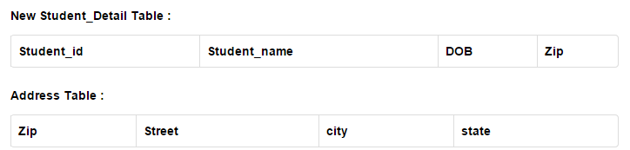
Database Normalization
Third normal form (3NF)
Notes:
Zip as in D04 E3F9, not “Dublin 4”

Slide 14
On Normalization
Frist, second and third Normalization are key to relational database design
They help us identify appropriate tables
There are other forms of Normalization
We don’t need to worry about these extra cases
Normalization can reduce processing speed on some operations
A pure normalized database isn’t always appropriate

Slide 15
ER Modeling: Where is the catch?
Lets have a look at a typical ER data model first

Slide 16
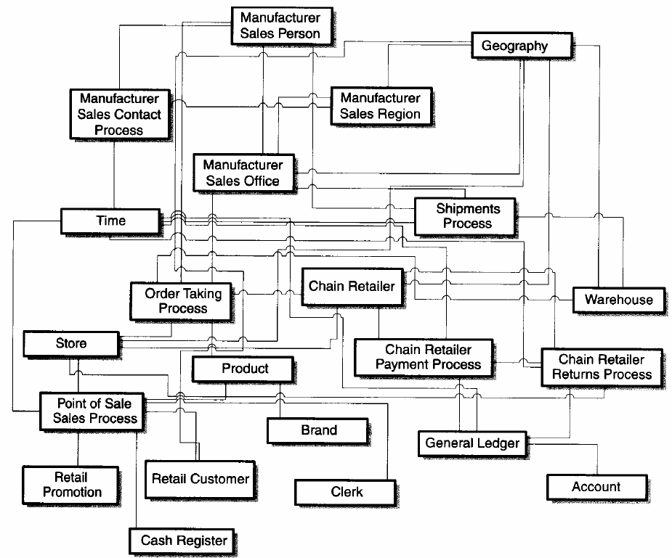
A Typical OLTP Oriented ER Data Model

Slide 17
ER Modeling: Where is the catch?
Some Observations
A Symmetric Model
All the tables look the same.
Which table is more important ? Which is the largest?
Which tables contain numerical measurements of the business?
Which tables contain nearly static descriptive attributes?
Very hard to visualize and keep it in head.
A large number of possible connections to any two (or more) tables.

Slide 18
ERD: Catch Continues
ERD and Normalization result in large number of tables
Hard to be understood by the users (DB programmers)
Hard to navigate by DBMS software in an optimum way
Real value of ERD is in using tables individually or in pairs.
Too complex for queries that span multiple tables with a large number of records.
Notes:
Entity Relationship Diagram

Slide 19
Dimensional Modeling and the Star Schema

Slide 20
How to simplify a Data Model?
Two general methods
De-Normalization
Dimensional Modeling
De-Normalization
Reverses the effect of Normalization
Reintroduce redundancy while reducing the number of tables

Slide 21
Dimensional Modeling
The database component of a data warehouse is described using a technique called dimensionality modelling.
Logical design technique that aims to present the data in a standard, intuitive form that allows for high-performance access.
Uses the concepts of ER modelling with some important restrictions.

Slide 22
Dimensional Modeling: Facts
Models data around two basic concepts: Facts & Dimensions.
Facts
Facts are numeric measurements (values) that represent a specific business aspect or activity.
Facts can be computed or derived at run-time (metrics).
Examples: Unit Cost, Sale Value, Quantity Sold

Slide 23
Dimensional Modeling: Dimensions
Dimensions
Dimensions are qualifying characteristics that provide additional perspectives to a given fact.
Examples: Date (Day, Month, Qtr, Year), Product (Type, Category)

Slide 24
The Dimensional Model
Every dimensional model (DM) is composed of
One table with a composite primary key, called the fact table
A set of smaller tables called dimension tables
Each dimension table has a simple (non-composite) primary key that corresponds exactly to one of the components of the composite key in the fact table.

Slide 25
Star Schema
Fact
Dim
Dim
Dim
Dim
Dim
Forms star-like structure,
which is called a star schema or star join
Star schema is a logical structure that has a fact table containing factual data in the centre, surrounded by dimension tables containing reference data, that can be denormalised.
Facts are generated by events that occurred in the past, and are unlikely to change, regardless of how they are analysed.

Slide 26
Star Schema
Dimension Table
Dimension Table
Fact Table
Dimension Table
Dimension Table

Slide 27
Fact Tables
The bulk of data in a data warehouses is in the Fact Tables, which can be extremely large.
It’s important to treat fact data as read-only data that will not change over time.
The most useful Fact Tables contain one or more numerical measures, or ‘facts’, that occur in each record and are both numeric and additive.
Most Useful Facts: Numeric and Additive.

Slide 28
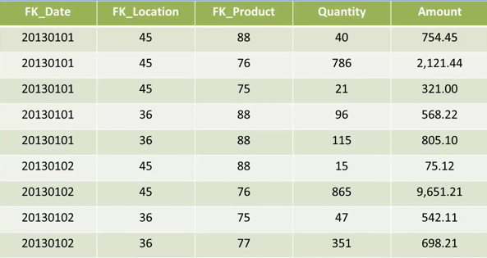
An example of a Fact Table

Slide 29
Dimension Tables
Dimension tables usually contain descriptive textual information.
Dimension attributes are used as the constraints in data warehouse queries.
Star schemas can be used to speed up query performance by de-normalizing reference information into a single table.

Slide 30
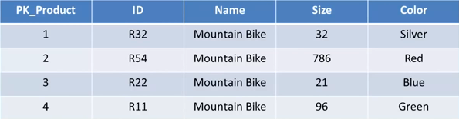
An example of a Dimension Table

Slide 31
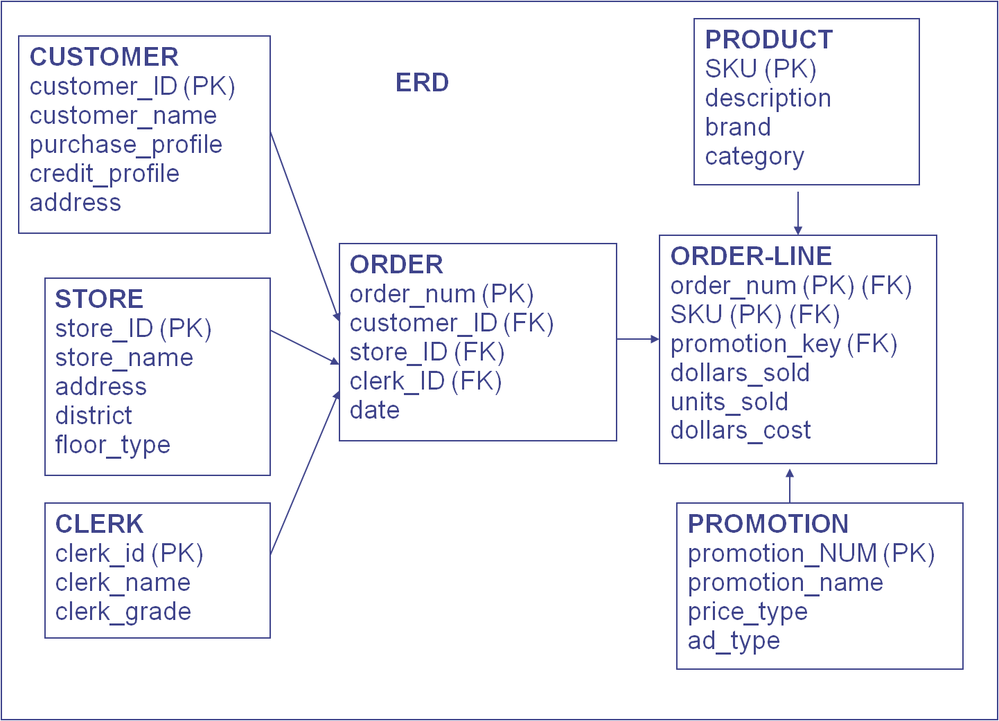
An Example - ERD

Slide 32
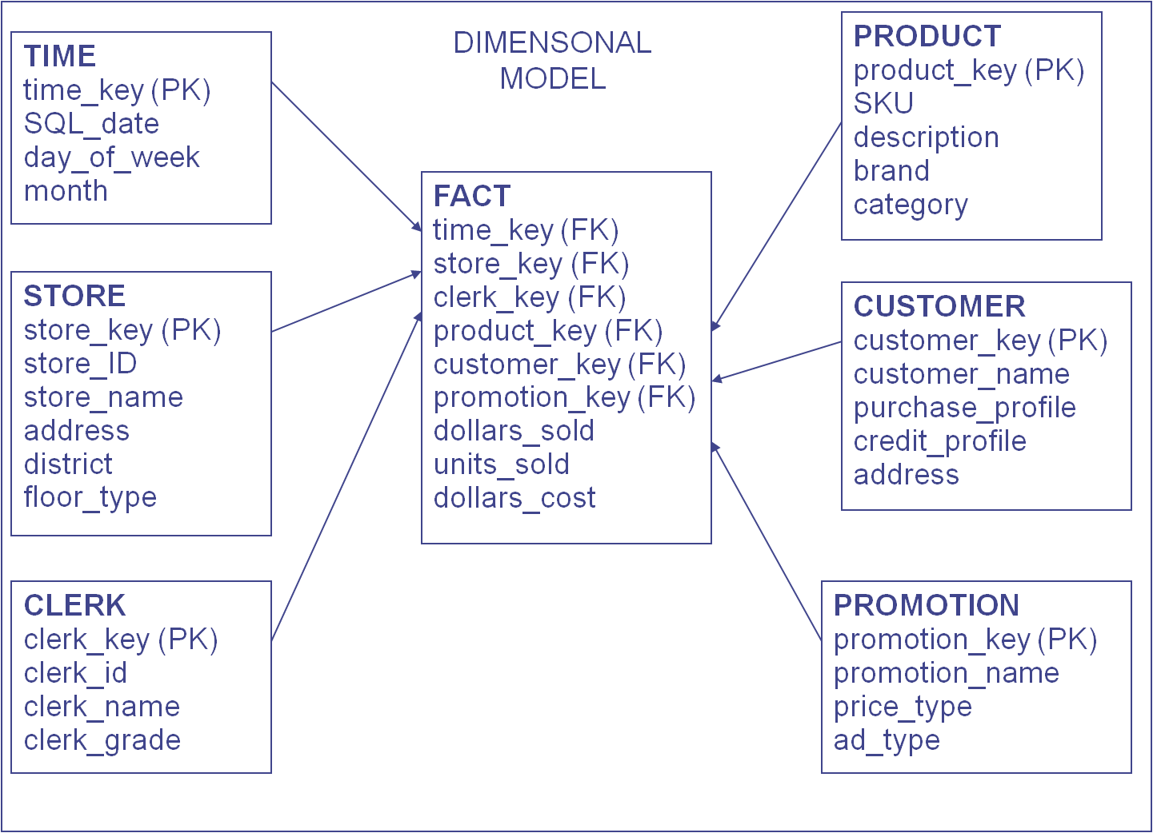
An Example – Dimensional Model

Slide 33
Benefits
Performance (natural partitioning, Single joins benefit SQL optimizer).
Usability/Simplicity (easy to read, interpret, join, calculate).
Reuse (Conformed dimensions reduce redundancy).

Slide 34
ER versus DM
Notes:
Entity-Relationship versus Dimensional Modeling

Slide 35
ER Properties
The focus of ER modeling:
Achieve processing and data storage efficiency by reducing data redundancy (storing data elements once).
Provide flexibility and ease of maintenance.
Protect the integrity of data by storing data once.
ER modeling and normalization are great for transaction processing as it makes transactions as simple as possible (as data stored only in one place).

Slide 36
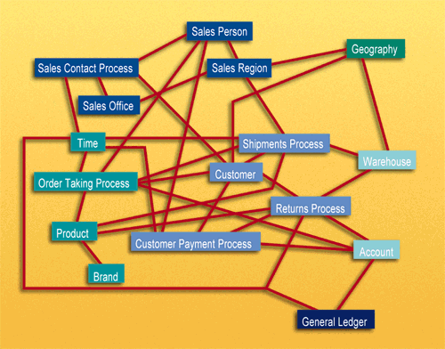
ER Model Example
Normalized databases become very complex making queries difficult and inefficient – a ‘spider web of joins’ is required for many queries. A database normalized for transaction processing is typically unusable for non-technical users who wish to perform queries.

Slide 37
ER Drawbacks
Data is not structured for analytical usage.
End users cannot understand or remember an ER model. End users cannot navigate an ER model. There is no graphical user interface (GUI) that takes a general ER model and makes it usable by end users.
Software cannot usefully query a general ER model.

Slide 38
Linking ER and DM Models
The key to understanding the relationship between DM and ER is that a single ER diagram breaks down into multiple DM diagrams, or ‘stars’.
Returns
Orders
Sales Contact
Payments

Slide 39
DM Strengths
The dimensional model has a number of important data warehouse advantages that the ER model lacks.
First, the dimensional model is a predictable, standard framework. Report writers, query tools, and user interfaces can all make strong assumptions about the dimensional model to make the user interfaces more understandable and to make processing more efficient.

Slide 40
DM Strengths
A second strength of the dimensional model is that the predictable framework of the star join schema withstands unexpected changes in user behavior.
The logical design can be done independently of expected query patterns.

Slide 41
DM Strengths
A third strength of the dimensional model is that it is ‘gracefully extensible’ to accommodate unexpected new data elements and new design decisions:
All existing tables (both fact and dimension) can be changed in place by simply adding new data rows in the table, or the table can be changed in place with a SQL alter table command.
Data should not have to be reloaded.
No query tool or reporting tool needs to be reprogrammed to accommodate the change.
Old applications continue to run without yielding different results. Adding new unanticipated facts (that is, new additive numeric fields in the fact table), as long as they are consistent with the fundamental grain of the existing fact table.

Slide 42
Final Points on ER versus DM
ER models are not appropriate for Data Warehouses. ER modeling does not really model a business; rather, it models the micro relationships among data elements.
ER models are wildly variable in structure. As such, it is extremely difficult to optimize query performance.

Slide 43
Final Points on ER versus DM
Dimensional Model:
SELECT description, SUM(quoted_price), SUM(quantity),
SUM(unit_price) , SUM(total_comm)
FROM order_fact of,
part_dimension pd
WHERE of.part_nr = pd.part_nr
GROUP BY description;
ER-Model:
SELECT description, SUM(quoted_price), SUM(quantity),
SUM(unit_price), SUM(total_comm)
FROM order o,
order_detail od,
part p,
customer c,
slsrep s
WHERE o.order_nr = od.order_nr
AND p.part_nr = od.part_nr
AND o.customer_nr = c.customer_nr
AND s.slsrep_nr = c.slsrep_nr
GROUP BY description;
Notice that the dimensional model only joins two tables, while the ER model joins all five in the ER Diagram. This is very typical of highly normalized ER models. Imagine a typical normalized database with 100s of tables

Slide 44
Designing a Data Warehouse

Slide 45
Prelims: Time Dimension
Every Data Warehouse will need Time information
i.e. a Time Dimension
Compose a generic Time Dimension Table
e.g. what are the different attributes you can use to describe 8th February, 2017.

Slide 46
Time Dimension
create table time_dimension (
date_key Number not null,
full_date Date,
day_of_week Number,
day_num_in_month Number,
day_num_overall Number,
day_name Varchar2(9),
day_abbrev Varchar2(3),
weekday_flag Varchar2(1),
week_num_in_year Number,
week_num_overall Number,
week_begin_date Date,
week_begin_date_key Number,
month Number,
month_num_overall Number,
month_name Varchar2(9),
month_abbrev Varchar2(3),
quarter Number,
year Number,
yearmo Number,
fiscal_month Number,
fiscal_quarter Number,
fiscal_year Number,
last_day_in_month_flag Varchar2(1),
same_weekday_year_ago_date Date,
primary key (date_key));

Slide 47
Data Model Design for Data Warehouses
Mart
Nine-Step Methodology includes following steps:
Choosing the subjects
Choosing the grain
Identifying and conforming the dimensions
Choosing the facts
Storing pre-calculations in the fact table
Rounding out the dimension tables
Choosing the duration of the database
Tracking slowly changing dimensions
Deciding the query priorities and the query mode
Notes:
The IBM Cognos Dynamic Query Mode is an enhanced Java-based query mode which offers the following key capabilities:
Query optimizations to address query complexity, data volumes and timeliness expectations with improved query execution techniques
Significant improvement for complex OLAP queries through intelligent combination of local and remote processing and better MDX generation

Slide 48
Step 1: Choosing The Subject
The subject (or function) refers to the subject matter of a particular data mart.
A business process is a major operational process in an organization.
Typically supported by a legacy system (database) or an OLTP.
Examples: Orders, Invoices, Inventory etc.

Slide 49
Step 1: Choosing The Subject
The first data mart to be built should be the one that is most likely to be
Delivered on time
Within budget
To answer the most commercially important business questions

Slide 50
Step 2: Choosing The Grain
Grain is the fundamental, atomic level of data to be represented.
Decide what a record of the fact table is to represent.
Grain is also termed as unit of analyses.
Typical grains
Transaction Lines
Individual Purchases
Daily aggregates (snapshots)
Monthly aggregates

Slide 51
Step 2: Choosing The Grain
Identify dimensions of the fact table. The grain decision for the fact table also determines the grain of each dimension table.
Also include time as a core dimension, which is always present in star schemas.

Slide 52
Step 3: Identifying & Conforming The Dimensions
Dimensions set the context for asking questions about the facts in the fact table.
If any dimension occurs in two data marts, they must be exactly the same dimension, or one must be a mathematical subset of the other.
A dimension used in more than one data mart is referred to as being conformed.

Slide 53
Step 3: Identifying & Conforming The Dimensions
Choose the dimensions that apply to each fact in the fact table.
Typical dimensions: time, product, customer etc.
Need to identify the descriptive attributes that explain each dimension.

Slide 54
Steps 4 & 5: Choosing the Facts
The grain of the fact table determines which facts can be used in the data mart.
Facts should be numeric and additive.
Example: Quantity Sold, Unit Cost etc.
Unusable facts include:
Fact at different granularity from other facts in table
Storing Pre-Calculations in the Fact Table
Once the facts have been selected each should be re-examined to determine whether there are opportunities to use pre-calculations.

Slide 55
Step 6: Rounding Out The Dimension Tables
Text descriptions are added to the dimension tables.
Text descriptions should be as intuitive and understandable to the users as possible.
Usefulness of a data mart is determined by the scope and nature of the attributes of the dimension tables.

Slide 56
Step 7: Choosing The Duration Of The Database
Duration measures how far back in time the fact table goes.
Very large fact tables raise at least two very significant data warehouse design issues.
Often difficult to source increasingly old data.
Sometimes old versions of important dimensions are used, not the most current ones. Known as the ‘Slowly Changing Dimension’ problem.
Notes:
Type 0 method is passive. Values remain as they were at the time the dimension record was first inserted.
Type 1: The new record replaces the original record. No trace of the old record exists.
Type 2: A new record is added into the customer dimension table. Therefore, the customer is treated essentially as two people.
Type 3: The original record is modified to reflect the change. Add columns.
Another change handling strategy involves using a surrogate (substitute) key as its primary key for the dimension table. (and keeping the original id).

Slide 57
Step 8: Tracking slowly changing dimensions
For example: a new record is added into the customer dimension table. Therefore, the customer is treated essentially as two people.
A change handling strategy involves using a surrogate (substitute) key as the primary key for the dimension table, and keeping the original id.
Notes:
Type 0 method is passive. Values remain as they were at the time the dimension record was first inserted.
Type 1: The new record replaces the original record. No trace of the old record exists.
Type 2: A new record is added into the customer dimension table. Therefore, the customer is treated essentially as two people.
Type 3: The original record is modified to reflect the change. Add columns.

Slide 58


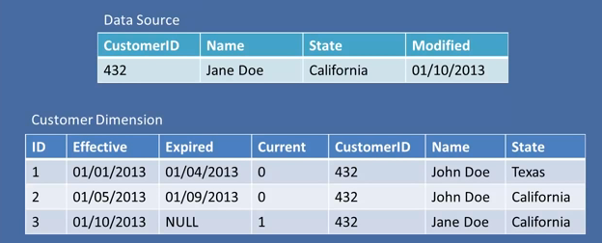
Step 8: Tracking slowly changing dimensions
Key
Notes:
Slowly Changing Dimensions
Type 0 method is passive. Values remain as they were at the time the dimension record was first inserted.
Type 1: The new record replaces the original record. No trace of the old record exists.
Type 2: A new record is added into the customer dimension table. Therefore, the customer is treated essentially as two people.
Type 3: The original record is modified to reflect the change. Add columns.

Slide 59
Simple DW Example
Supermarket (Chain Store)
Business Area: Sales
Grain: Individual Purchases
Dimensions:
Time
Product
Store
Customer
Employee
Facts:
Total Sale Value
Number of Items
Total Cost Value

Slide 60
Simple DW Example
Customer
Time
Individual Purchases
Employee
Products
Store

Slide 61
More Detail

Slide 62
More Detail
Additional Time Dimension
New Composite Key
Original Key Replaced

Slide 63
Closing Notes

Slide 64

Summary
Over the last two lectures we have introduced the idea of data warehouses
Data warehouses evolved to address the issues of using transactional databases to answer new kinds of questions
IBM has a very detailed Redbooks on dimensional modeling that is well worth looking at:
http://www.redbooks.ibm.com/redbooks/pdfs/sg247138.pdf

